Slide 1
How to Record Lectures Using Zoom

Slide 2
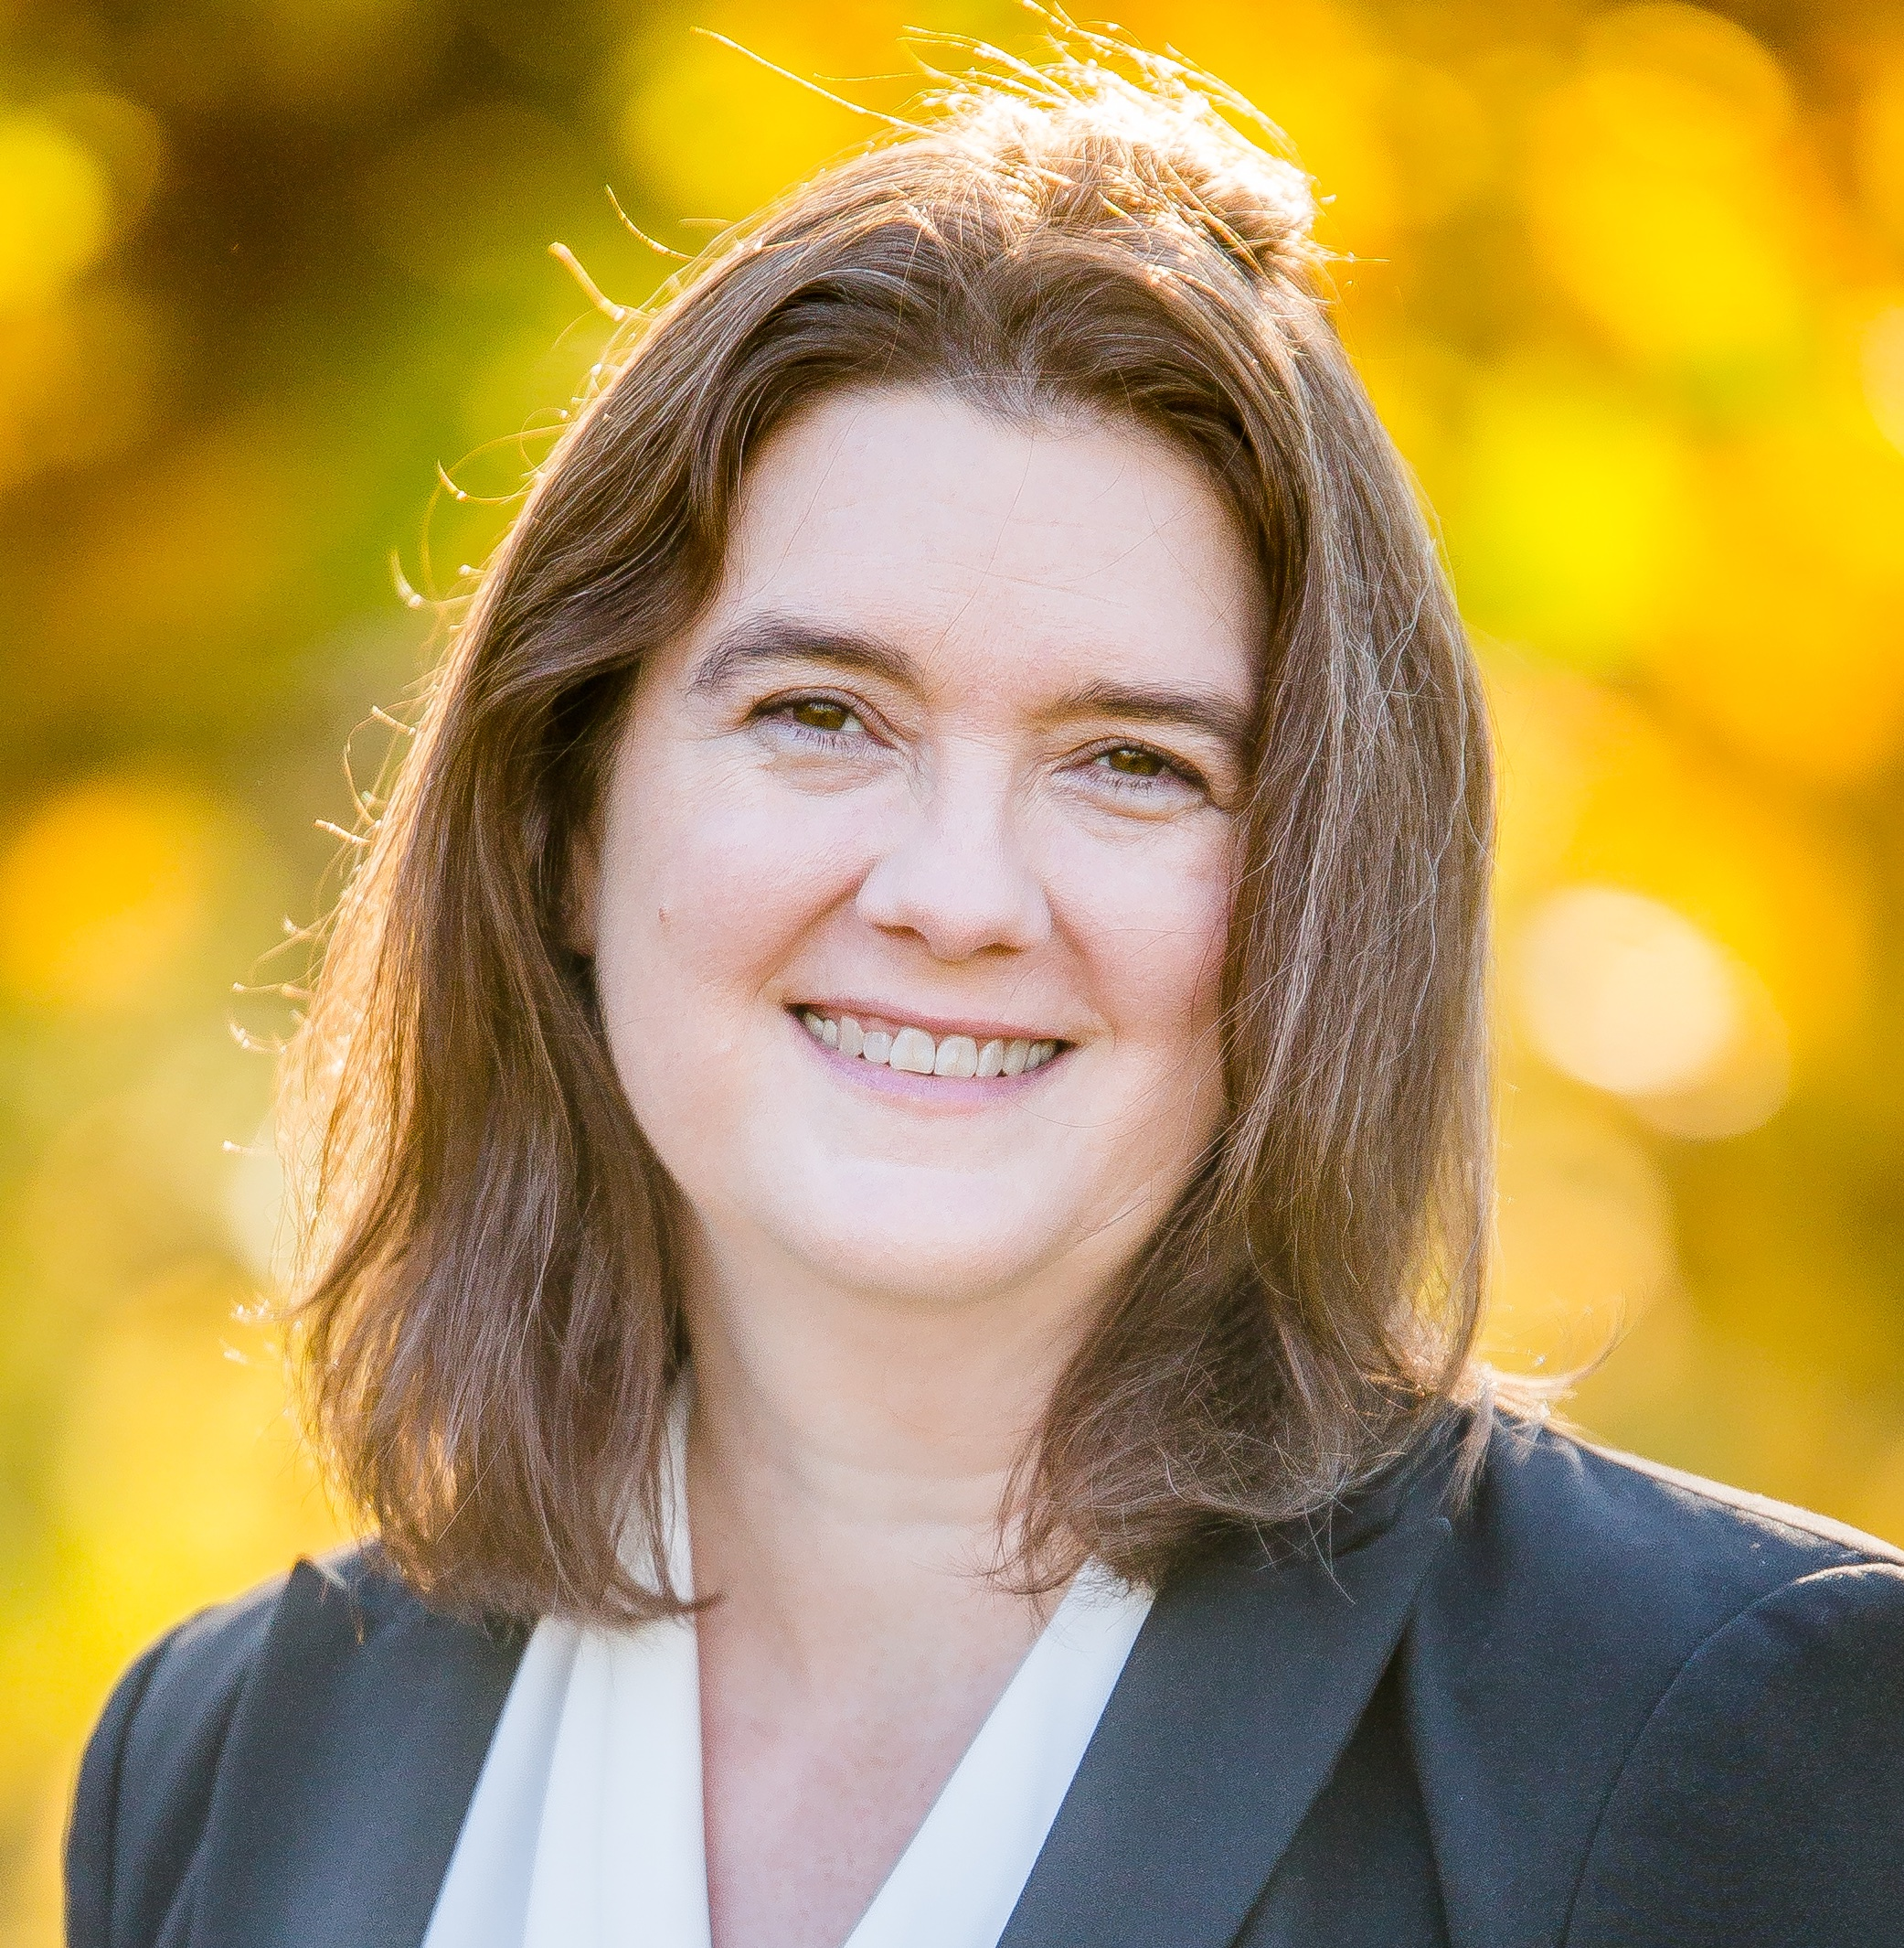
Stacy Smith
Assistant Professor
Department of Sociology

Slide 3
Agenda
Recording Synchronous Lectures
Recording Asynchronous Lectures
Saving Lectures

Slide 4
Two Ways to Record Lectures
Synchronous
Asynchrnous
Record a live lecture as you interact with students in real-time
Characteristics
  Longer (w/o editing)
  Includes student images/communication
Record a lecture to deliver to students asynchronously
Characteristics
  Can plan for shorter segments
  Does not include student images/communication

Slide 5
Synchronous Recording in Zoom

Slide 6
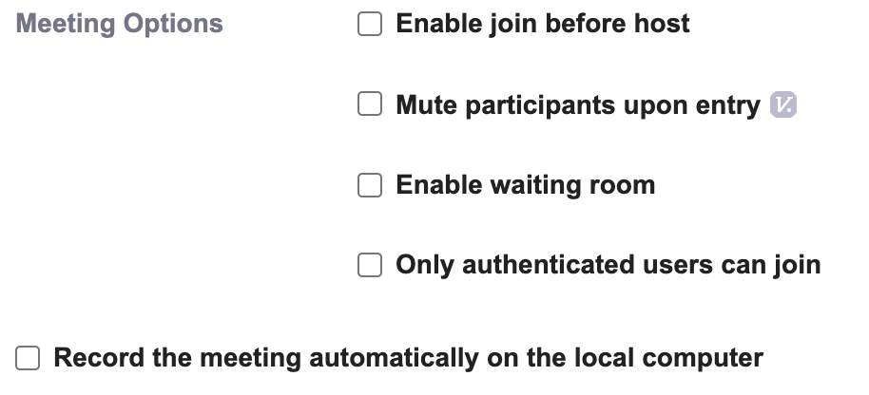
Steps to Recording a Synchronous Lecture
Inform your students that you will be recording the zoom session. Include where and how the video will be distributed. Allow students to remain silent and/or keep videos off if they do not wish to be recorded.
Log in to zoom
Create your meeting. You may choose “Record the meeting automatically on the local computer” if you like.

Slide 7
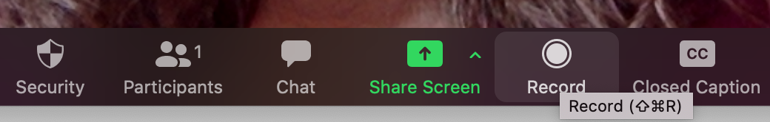
Steps to Recording a Synchronous Lecture
Start your meeting. If you did not set the meeting to record, click on the “record” button at the bottom of your Zoom window.

Slide 8
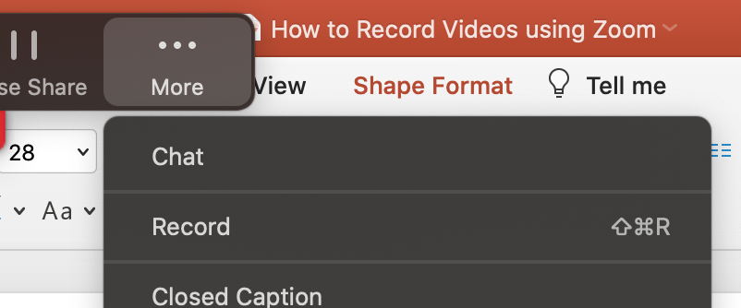
Steps to Recording a Synchronous Lecture
Note: When you share your screen, the control bar moves to the top of the screen and may disappear. Mouse over to make it reappear. Click on the “More” button on the right to access recording controls.

Slide 9
Asynchronous Recording in Zoom

Slide 10
Steps to Recording an Asynchronous Lecture
Using logical beginning and ending points, divide longer lectures into smaller segments (5 – 20 minutes).
  Design a way for students to know how many lecture videos are included in a course module.
Decide which of the following strategies you prefer to use:
  Your headshot video remains on screen for the entire lecture (largest file size)
  Your headshot video is on for an introduction and then is turned off (medium file size)
  Your headshot video is never on; Zoom records only your screen share(s) (smallest file size)

Slide 11
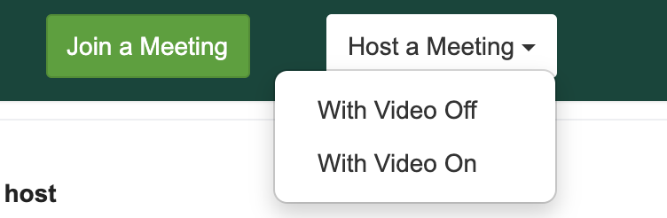
Steps to Recording an Asynchronous Lecture
Log in to Zoom
Click on “Host a Meeting.” A Dropdown box will appear.
Choose “With Video On.” A Zoom window will appear.

Slide 12
Steps to Recording an Asynchronous Lecture
The Zoom window that appears can be compared to an empty room. At this point, nothing is being recorded and you are alone.
Open any files that you intend to use via screen share.
  Note: if you change documents or programs, you will need to stop sharing your screen and start sharing the next document. Zoom records what happens through the Zoom app, not your desktop.
  Note: Videos do not share well through Zoom. Instead, provide students with a link to watch the video on their own time.

Slide 13
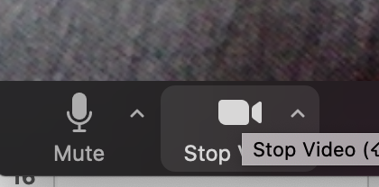
Steps to Recording an Asynchronous Lecture
If you chose option c on Slide 10, turn your video off now.
The button is in the lower left corner of your Zoom window.

Slide 14
Steps to Recording an Asynchronous Lecture
Click the “Record” button at the bottom of your Zoom window.

Slide 15
Steps to Recording an Asynchronous Lecture
Note: When you share your screen, the control bar moves to the top of the screen and may disappear. Mouse over to make it reappear. Click on the “More” button on the right to access recording controls.

Slide 16
Steps to Recording an Asynchronous Lecture
If you chose option b on Slide 10, record your introduction and then turn your video off.
The button is in the lower left corner of your Zoom window.
If you chose option a on Slide 10, record your lecture, leaving the video on.

Slide 17
Saving Lectures

Slide 18
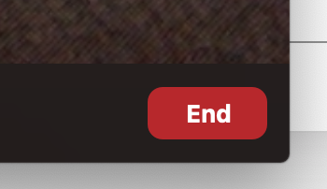
How to Save your Zoom Lecture
When you have completed your lecture or lecture segment, click the “End” button in the lower right corner of the Zoom window.
A drop-down menu appears. Click “End Meeting for All”

Slide 19
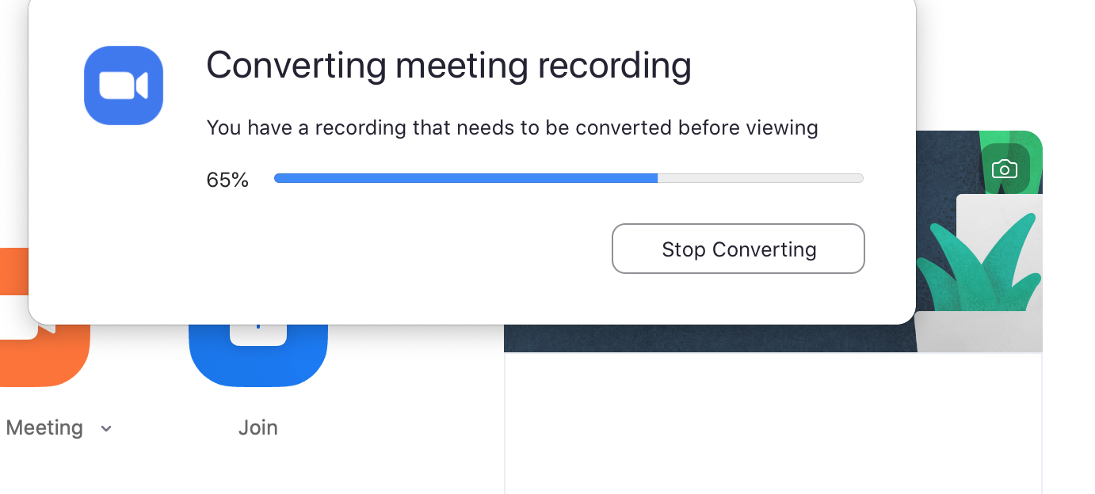
How to Save your Zoom Lecture
A dialogue box appears, showing you the progress as Zoom converts your meeting recording into audio and video formats.
Conversion time varies depending on file size.

Slide 20
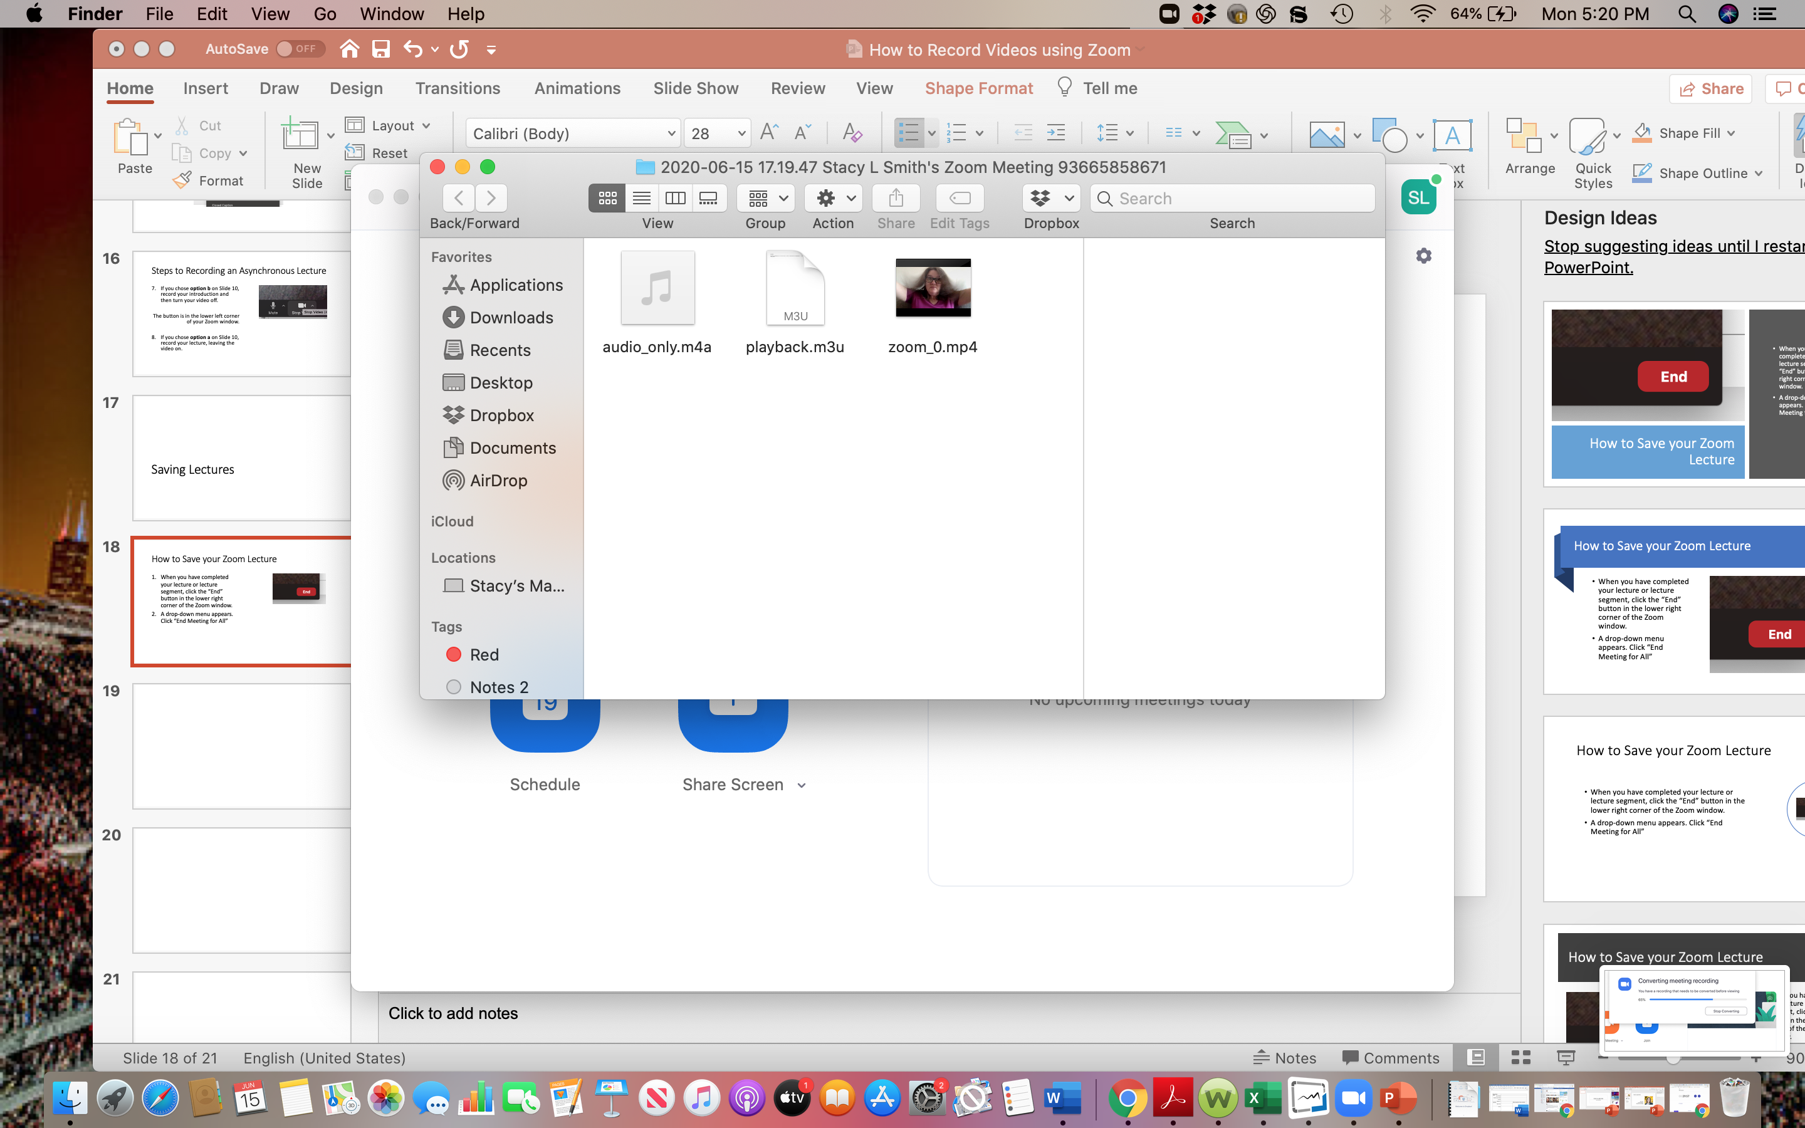
How to Save your Zoom Lecture
The files appear in a dialogue box on your screen. These are saved within the Zoom app.

Slide 21
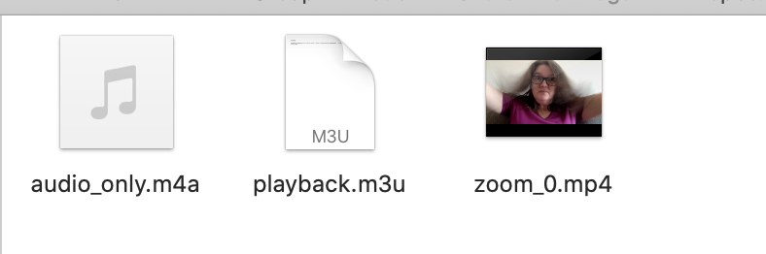
How to Save your Zoom Lecture
File Types
  Audio Only
  Mp3 URL
  Video
Rename and move your files.

Slide 22
Recap

Slide 23
Recap
We have covered:
Synchronous Lectures
Asynchronous Lectures
How to Save Lectures
Check out the website for information on:
  How to upload videos to MediaSpace and
  How to request captioning for mediaspace videos

